Slide 1
mySetu
Analysis & Functionality Model

Slide 2
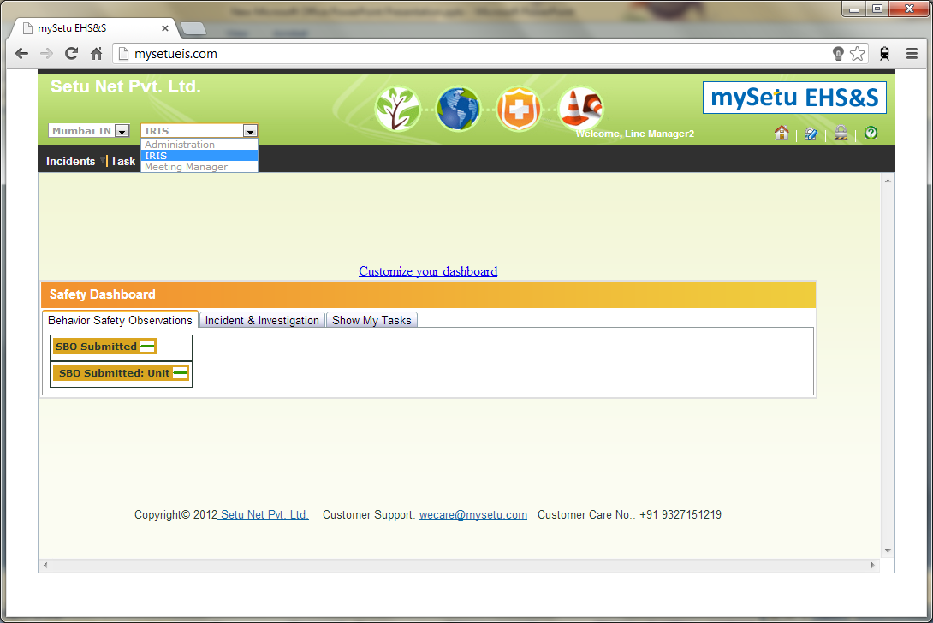
LM – Select IRIS

Slide 3
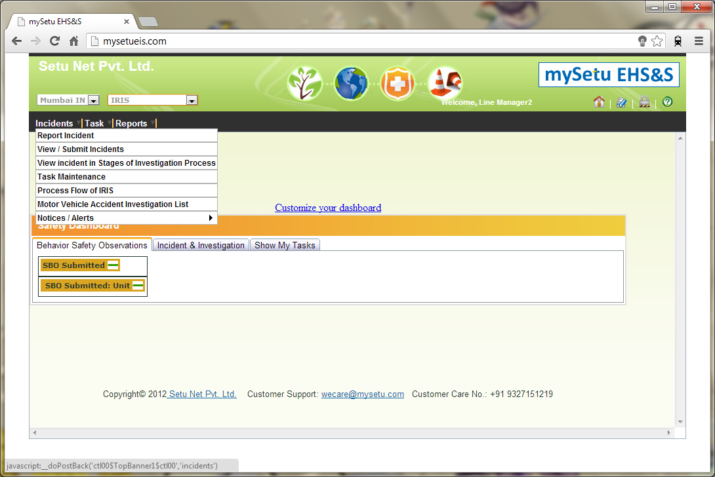
LM – Incidents

Slide 4
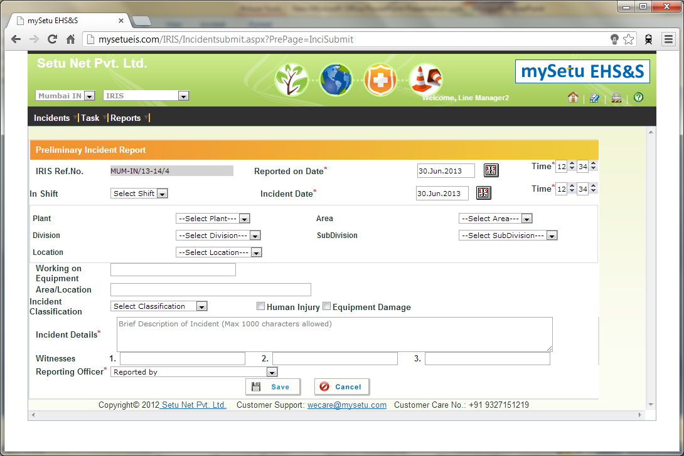
LM – Incidents / Report Incident

Slide 5
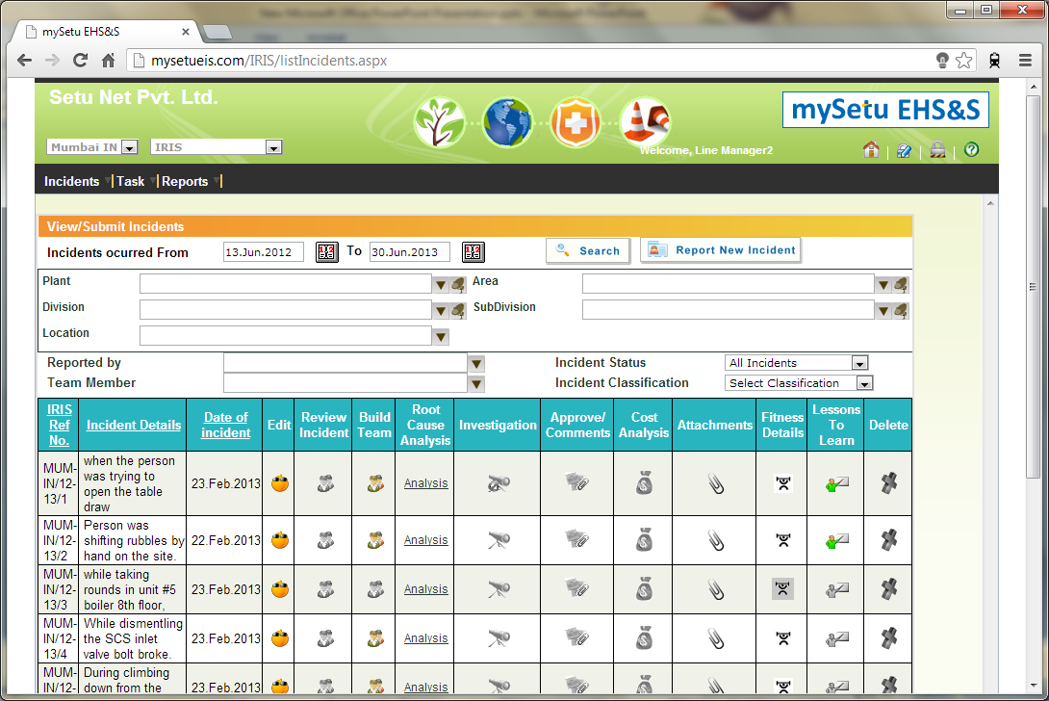
LM – Incidents / View-Submit

Slide 6
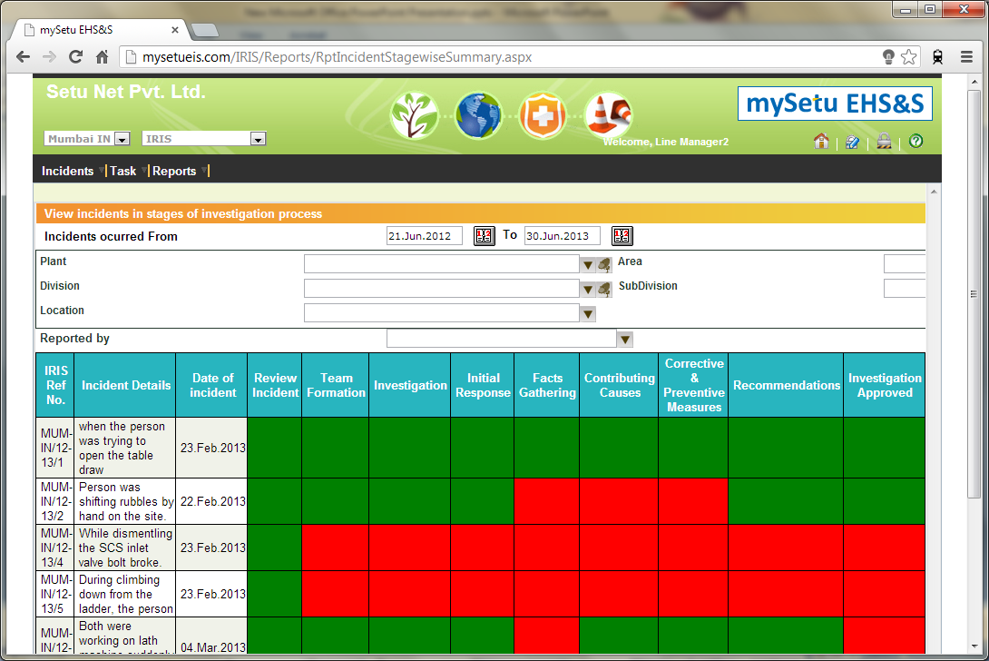
LM – Incidents / Stages

Slide 7
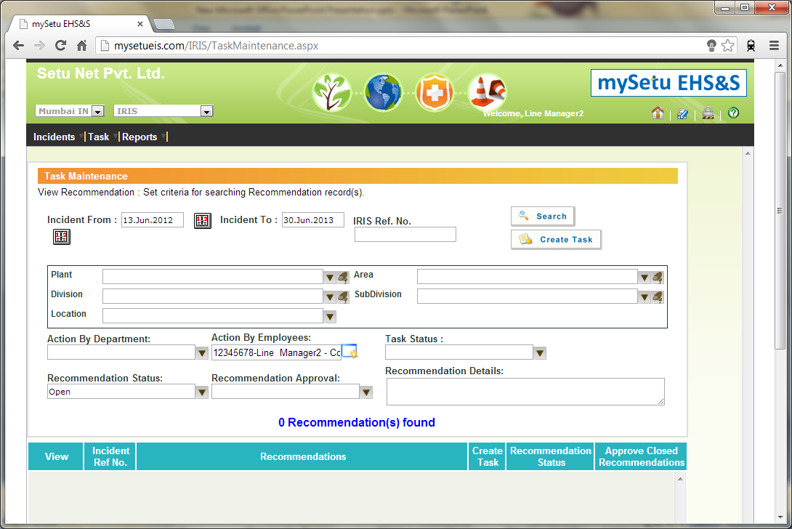
LM – Incidents / Task Maintenance

Slide 8
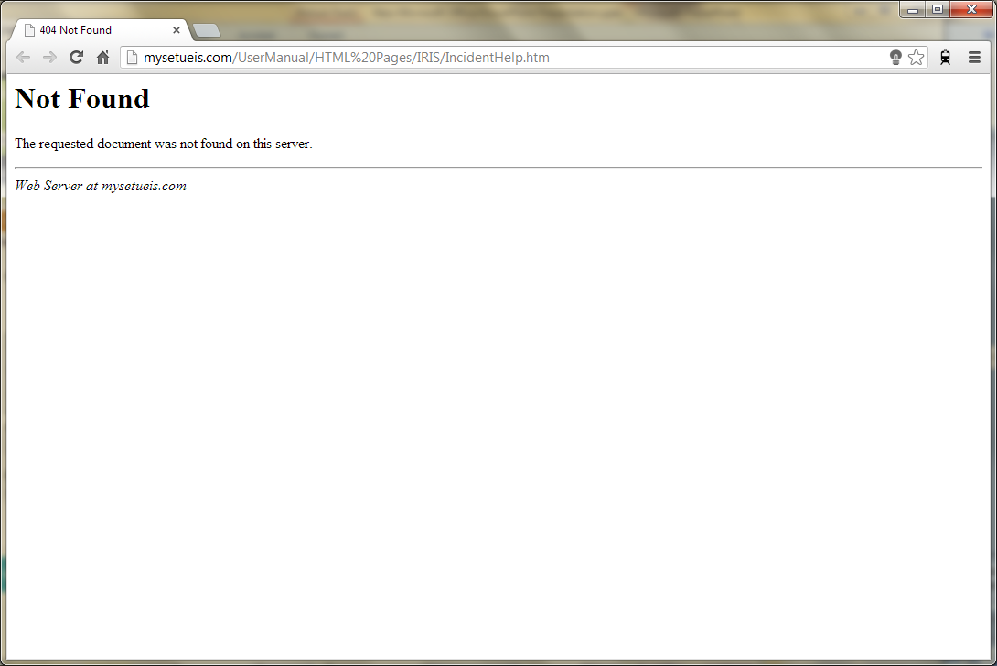
LM – Incidents / Process Flow

Slide 9
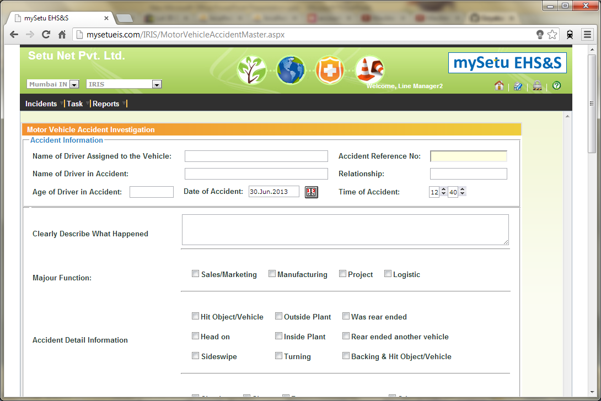
LM – Incidents / MV Accident Investigation

Slide 10
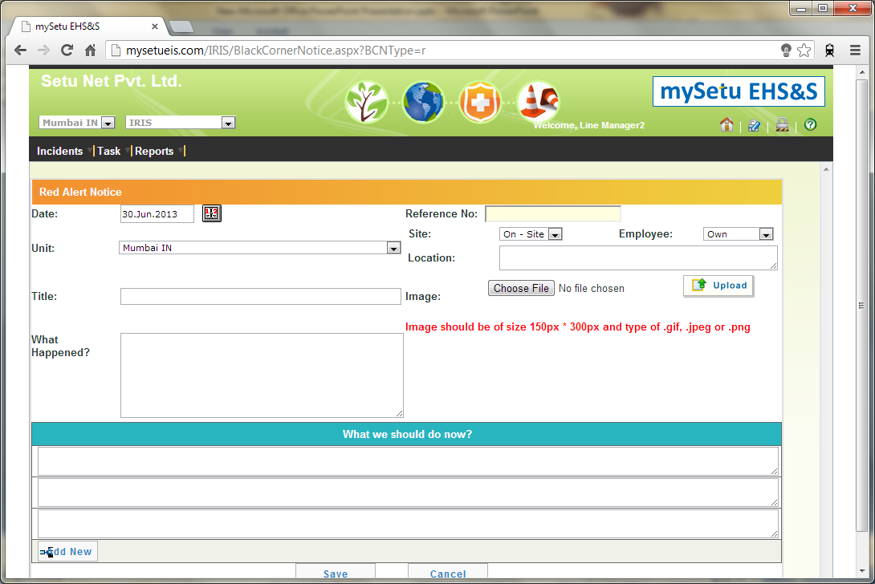
LM – Incidents / Notice-Alerts

Slide 11
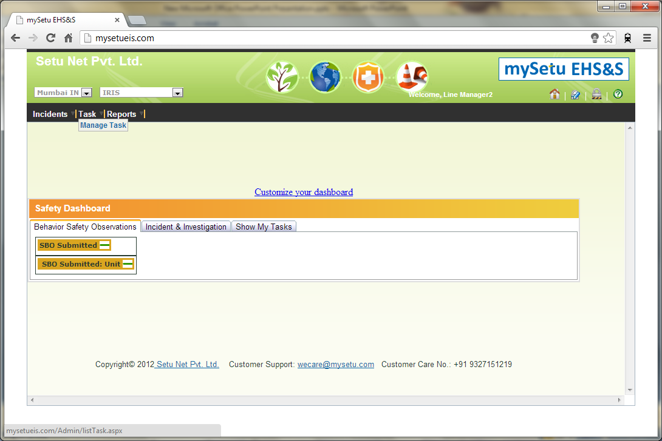
LM – Manage

Slide 12
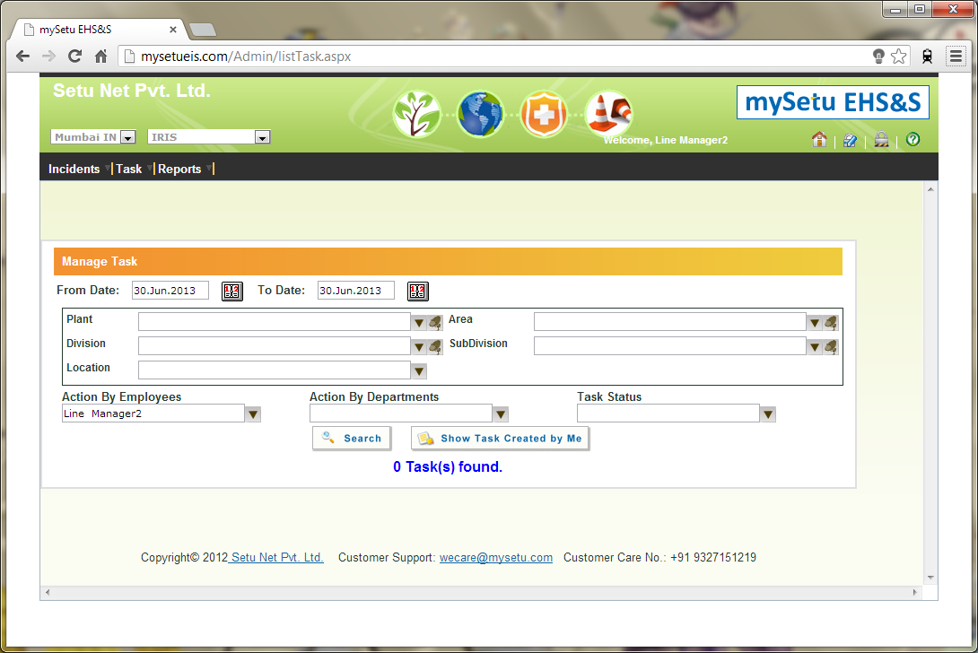
LM – Manage / Task

Slide 13
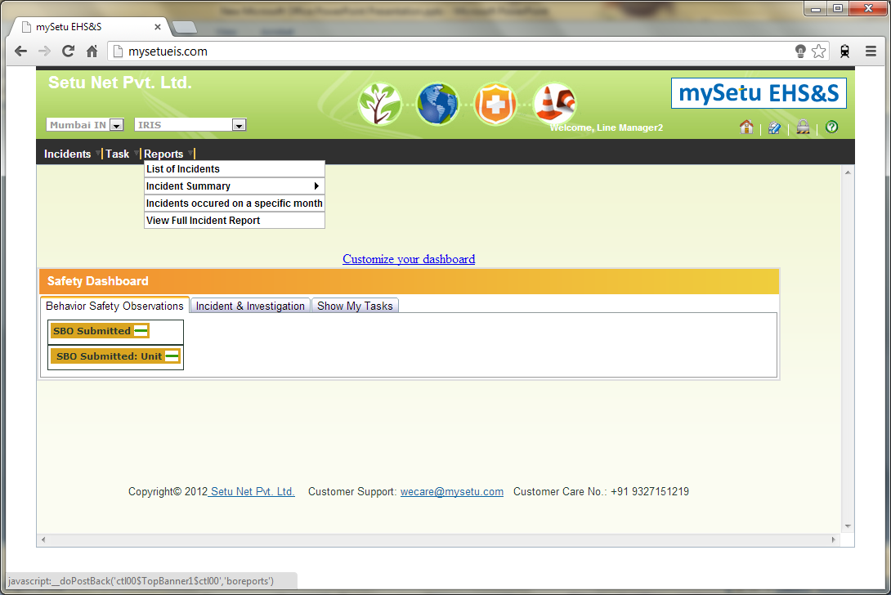
LM – Reports

Slide 14
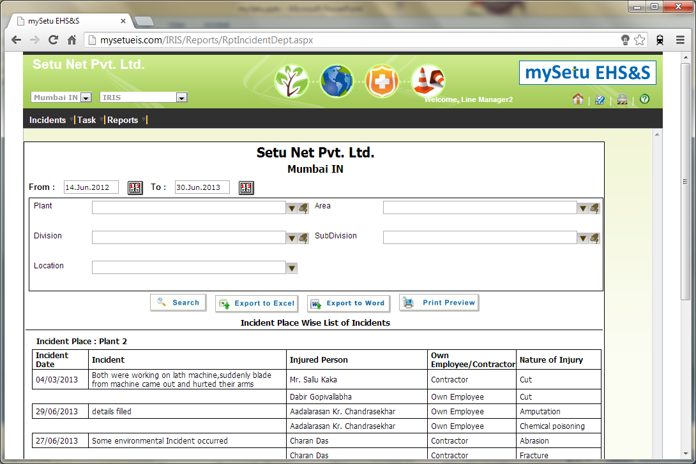
LM – Reports / List

Slide 15
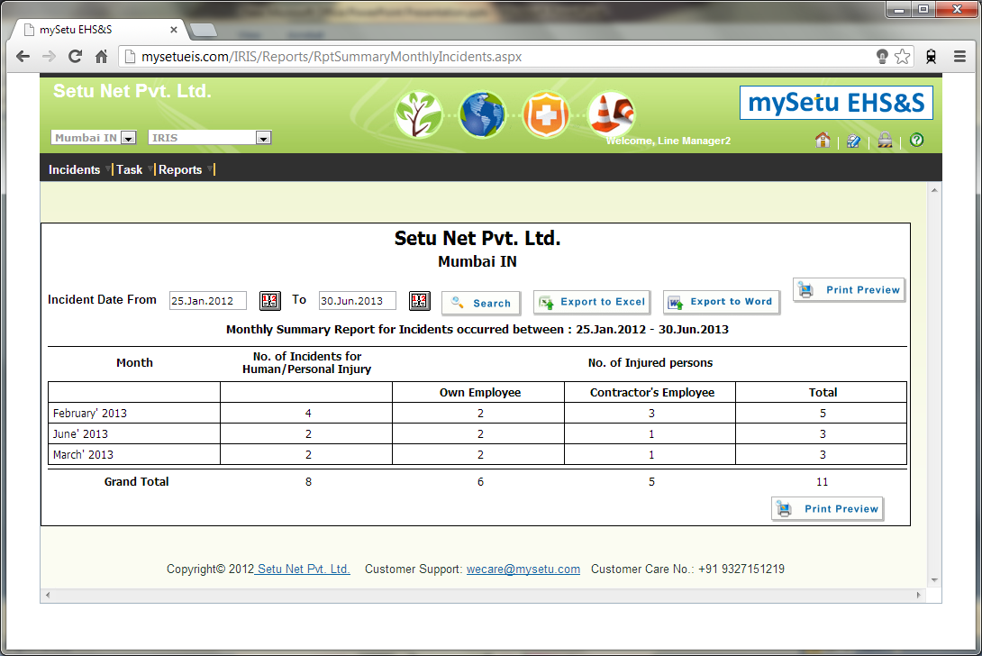
LM – Reports / Summary / Monthly

Slide 16
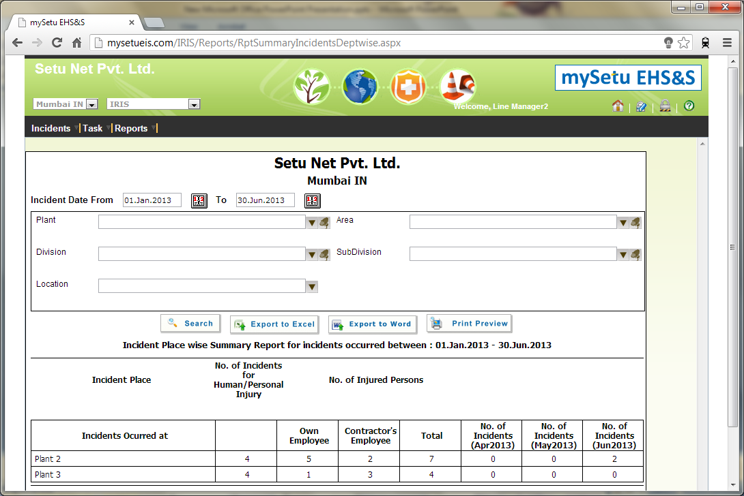
LM – Reports / Summary / Placewise

Slide 17
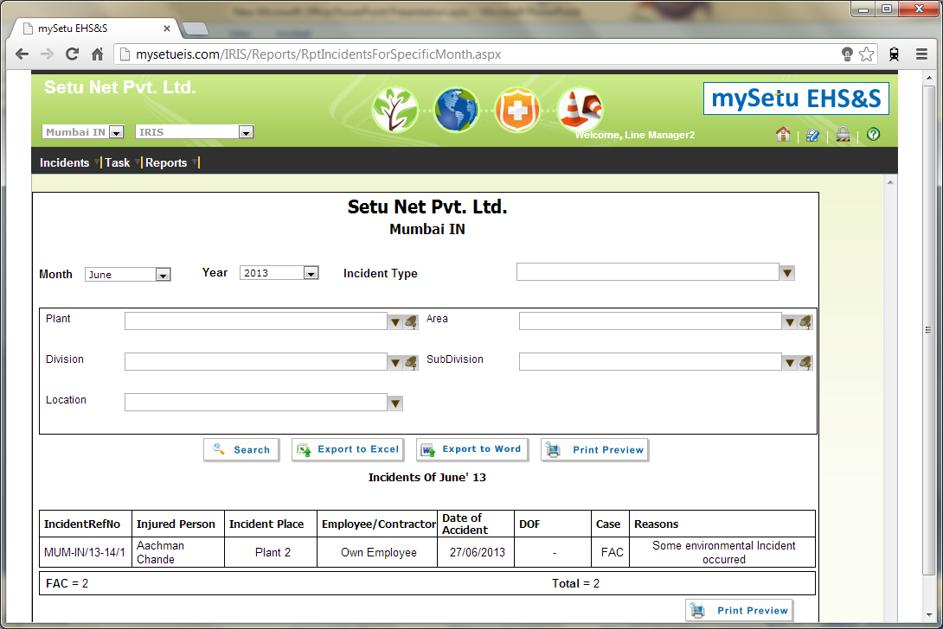
LM – Reports / Specific Months

Slide 18
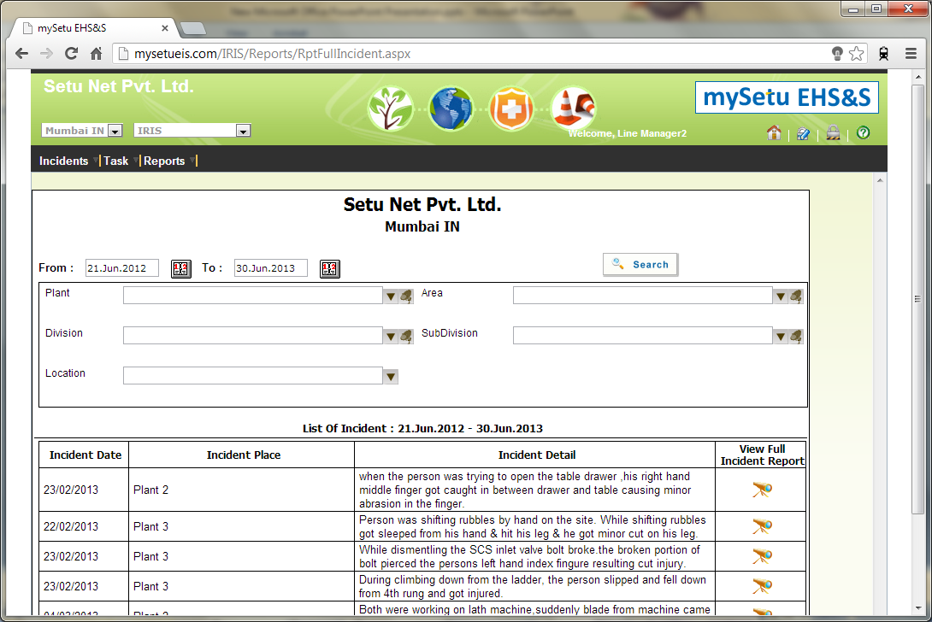
LM – Reports / Full Incident

Slide 19
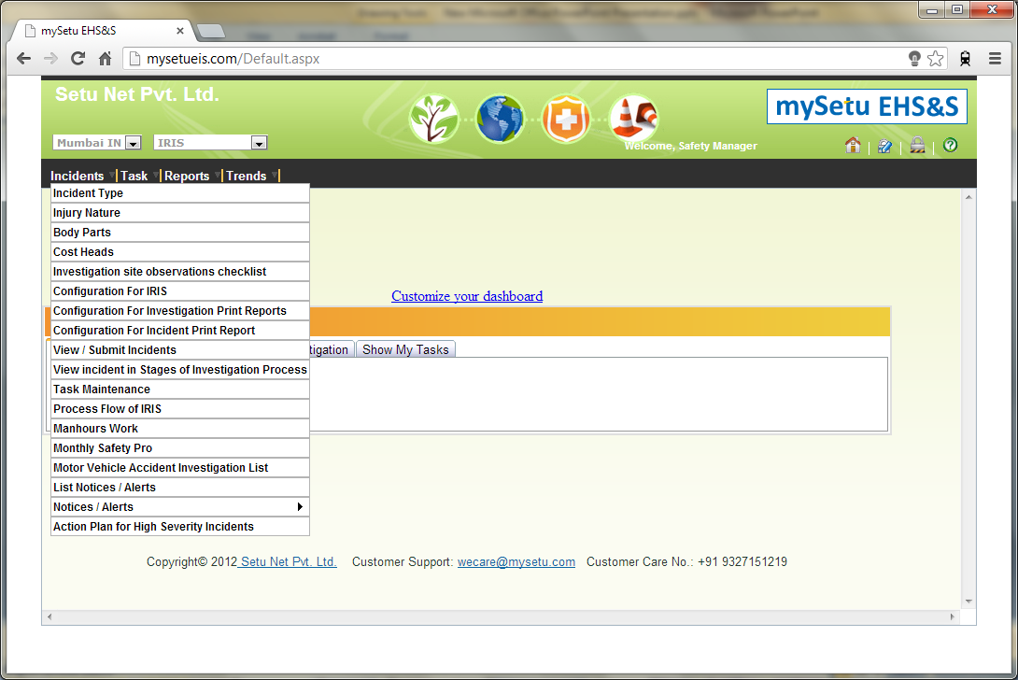
SM – Incidents

Slide 20
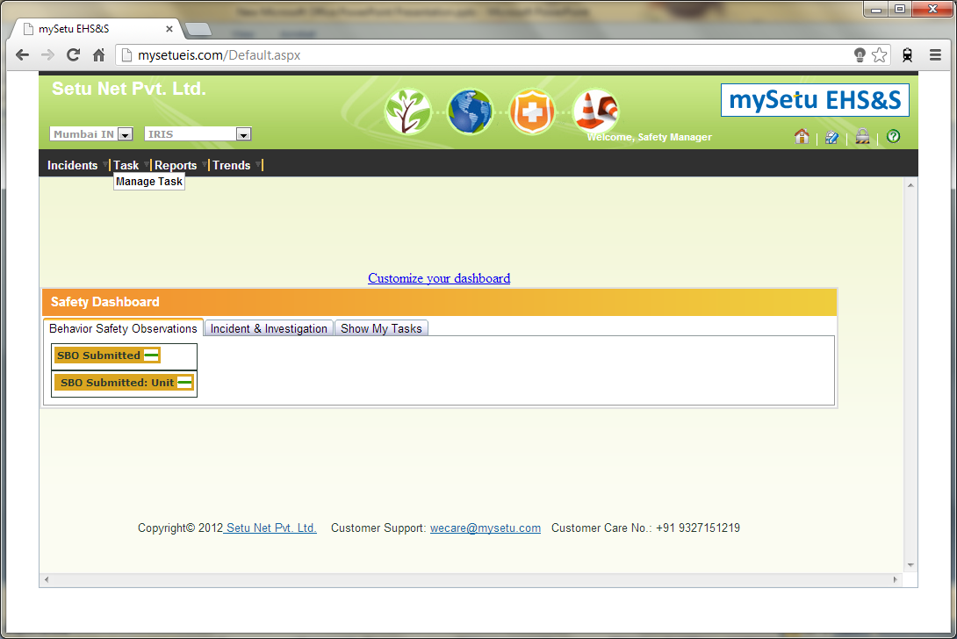
SM – Tasks

Slide 21
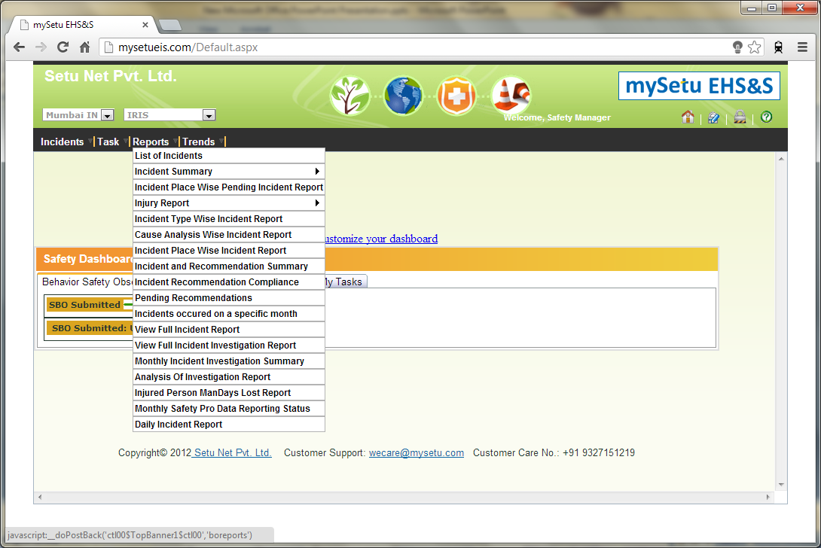
SM – Reports

Slide 22
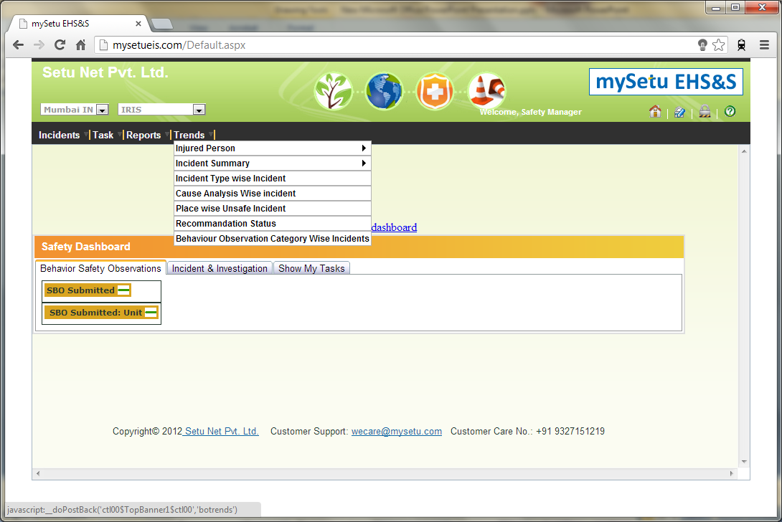
SM – Trends

Slide 23
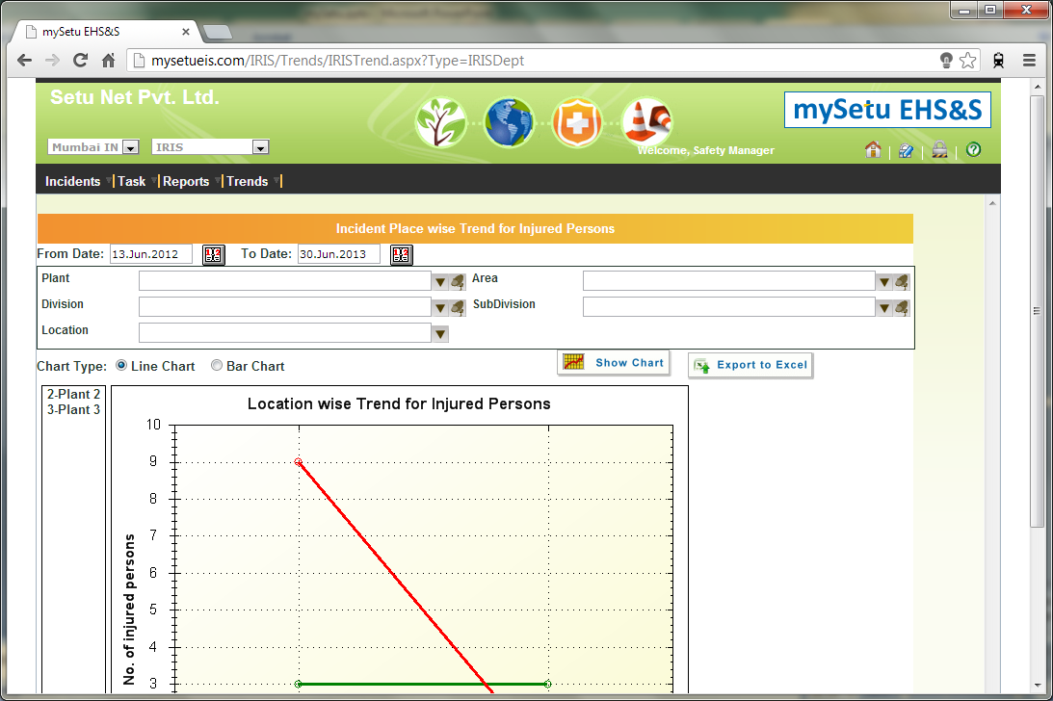
SM – Trends / Injured Person

Slide 24
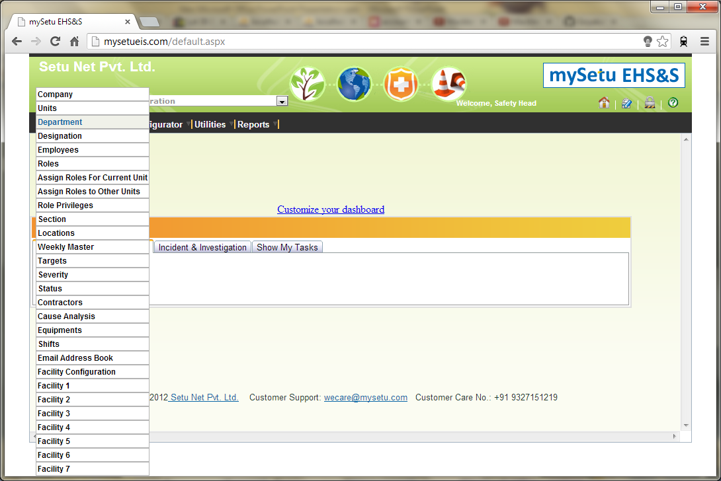
SH – Administration

Slide 25
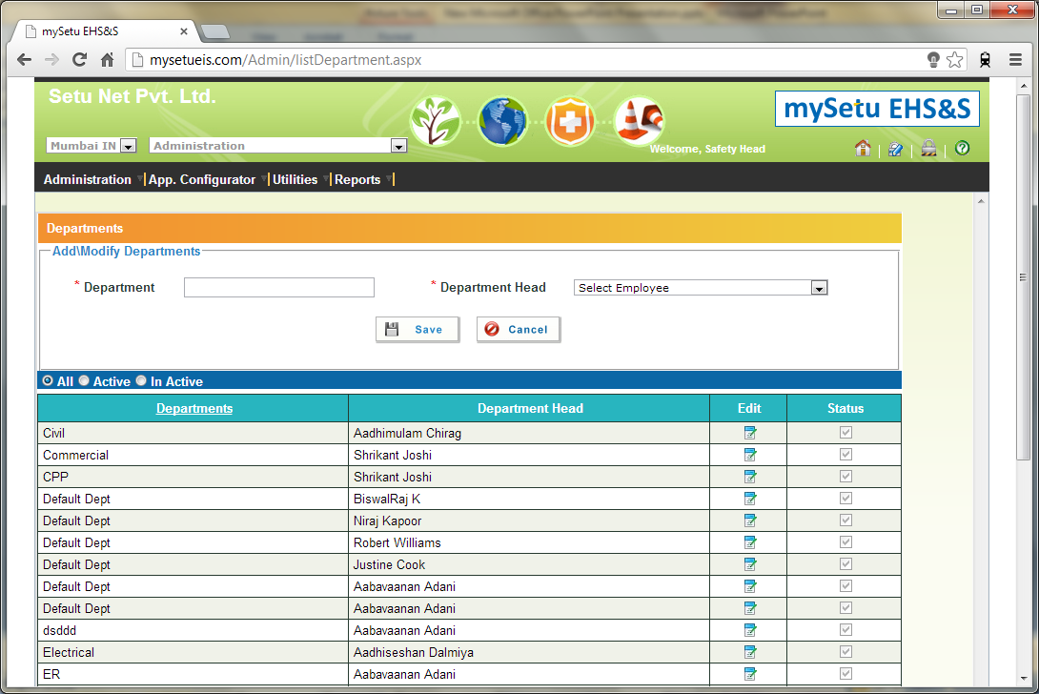
SH – Admin / Dept

Slide 26
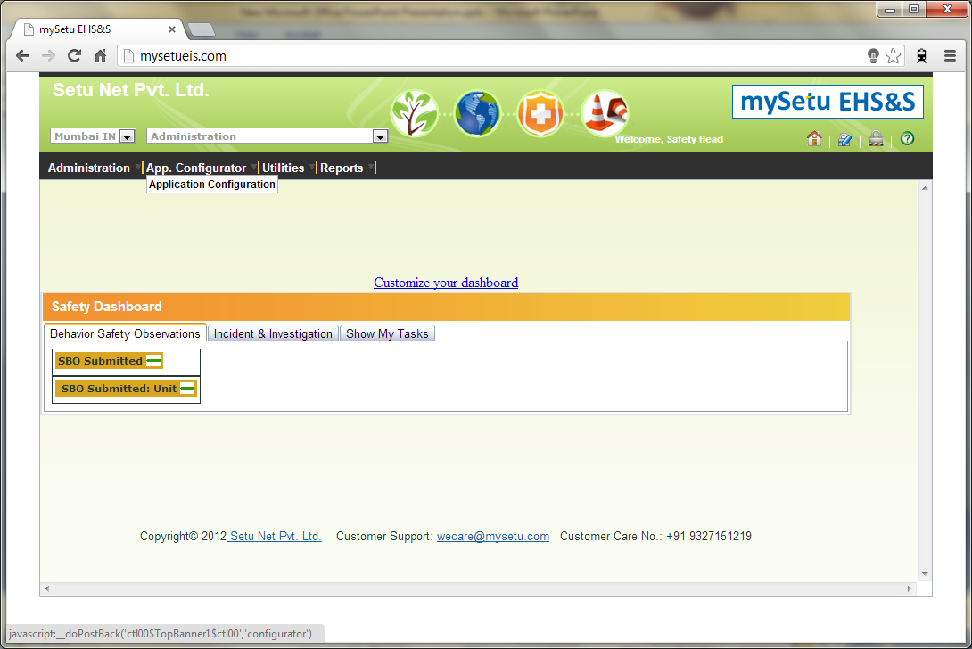
SH – App. Config

Slide 27
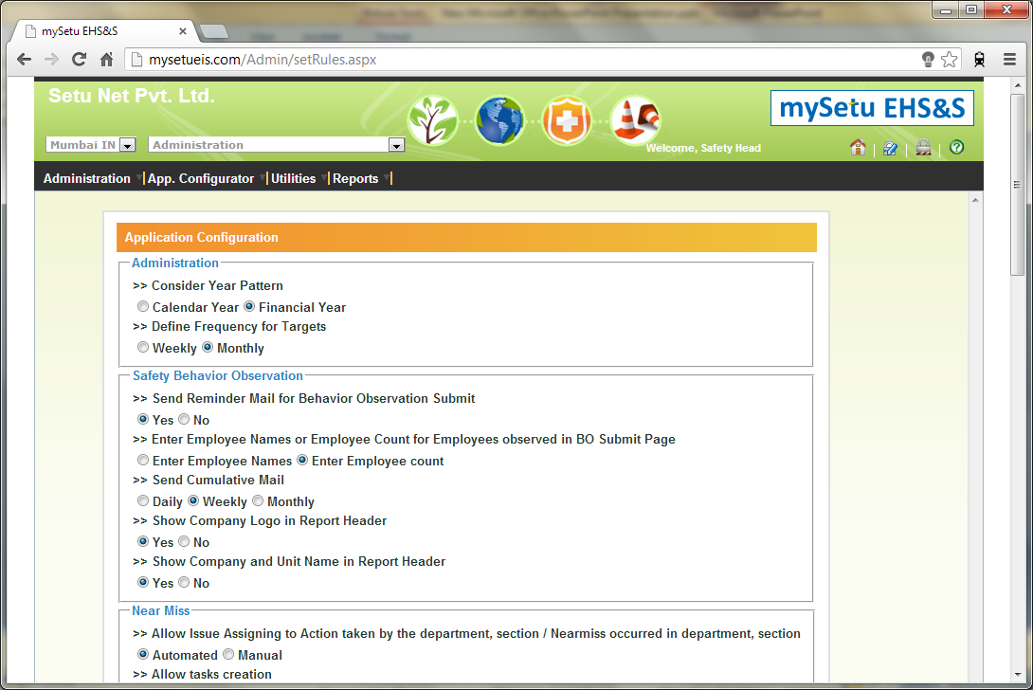
SH – App Config. / Config

Slide 28
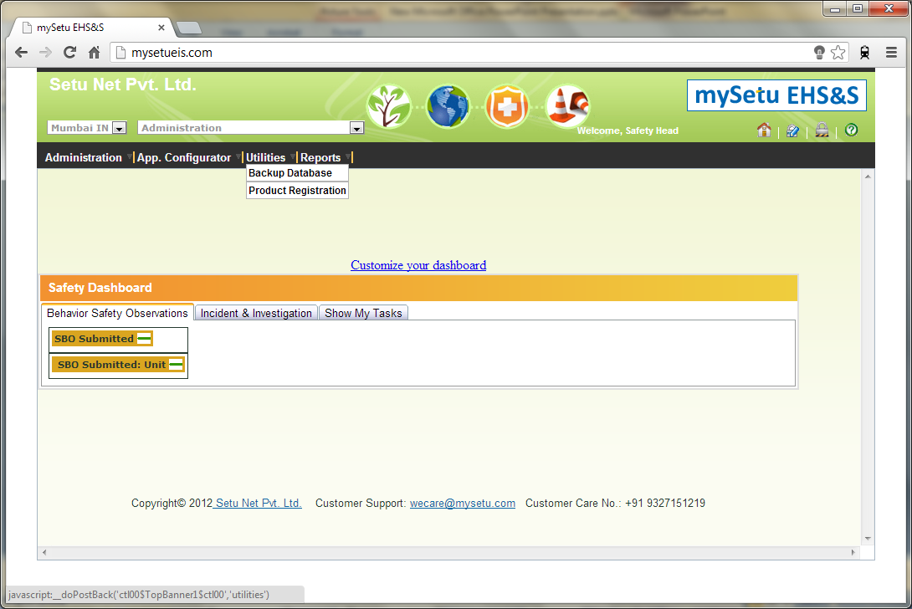
SH – Utilities

Slide 29
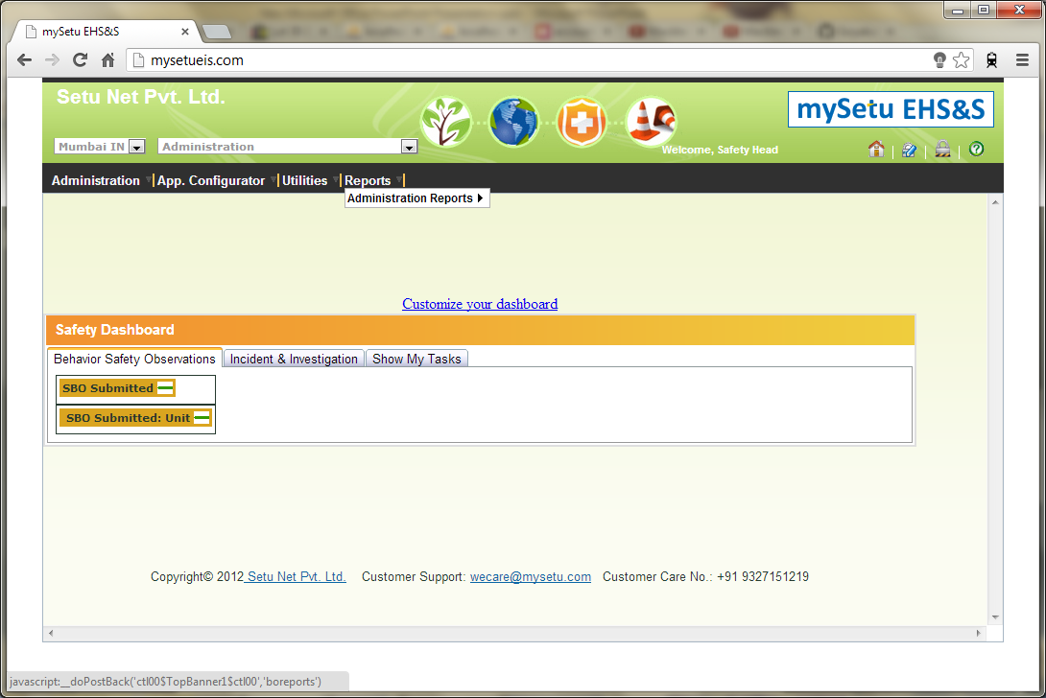
SH – Reports

Slide 30
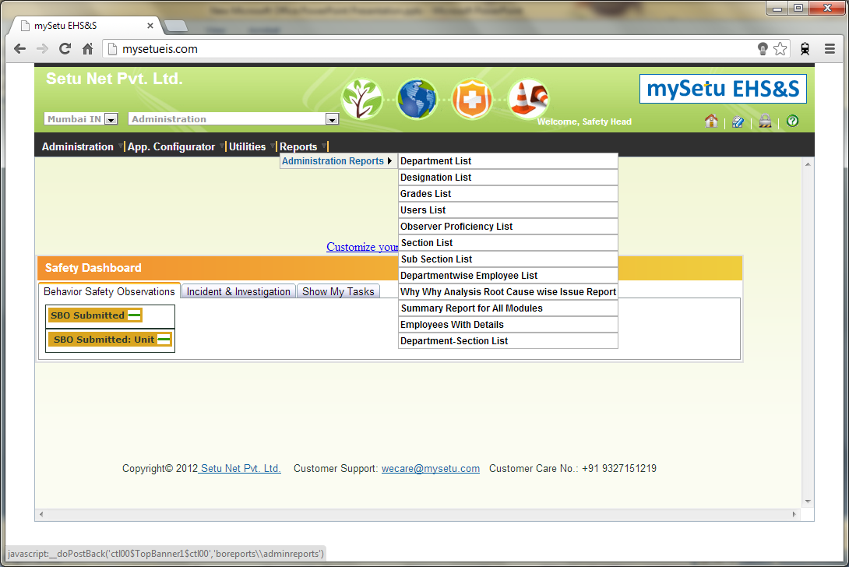
SH – Reports / Admin Reports

Slide 31
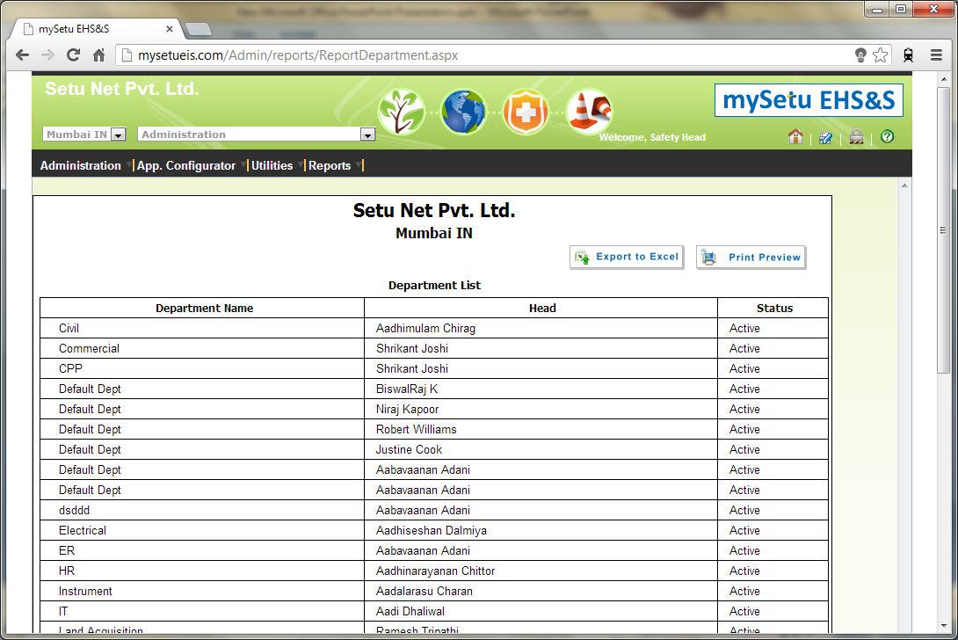
SH – Reports / Admin Reports / Dept

Slide 32
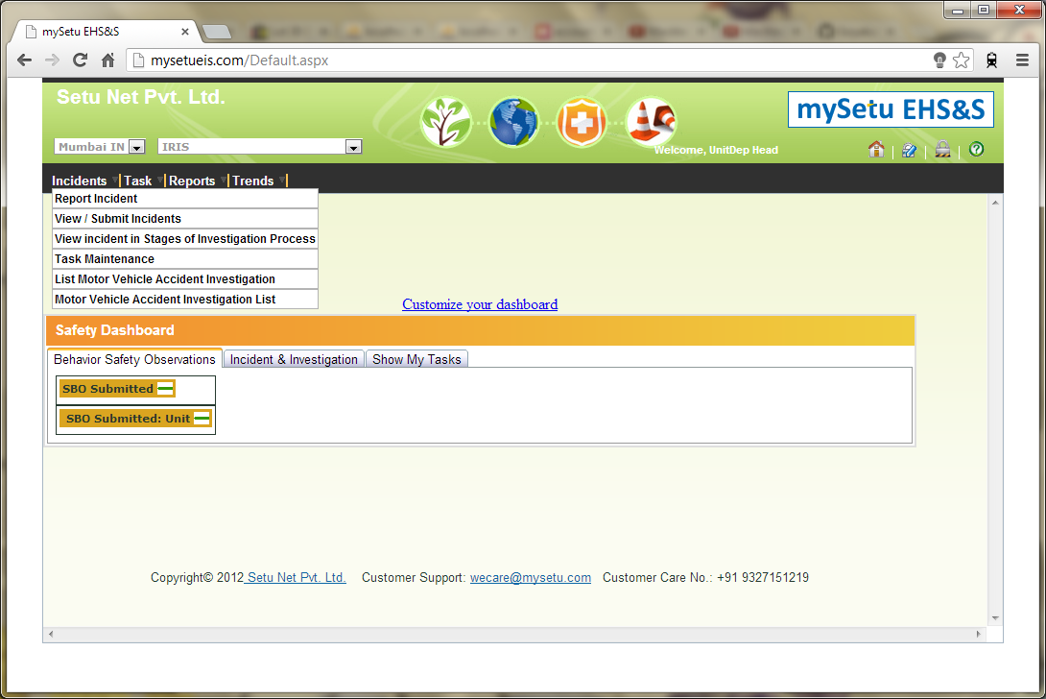
UDH – Incidents

Slide 33
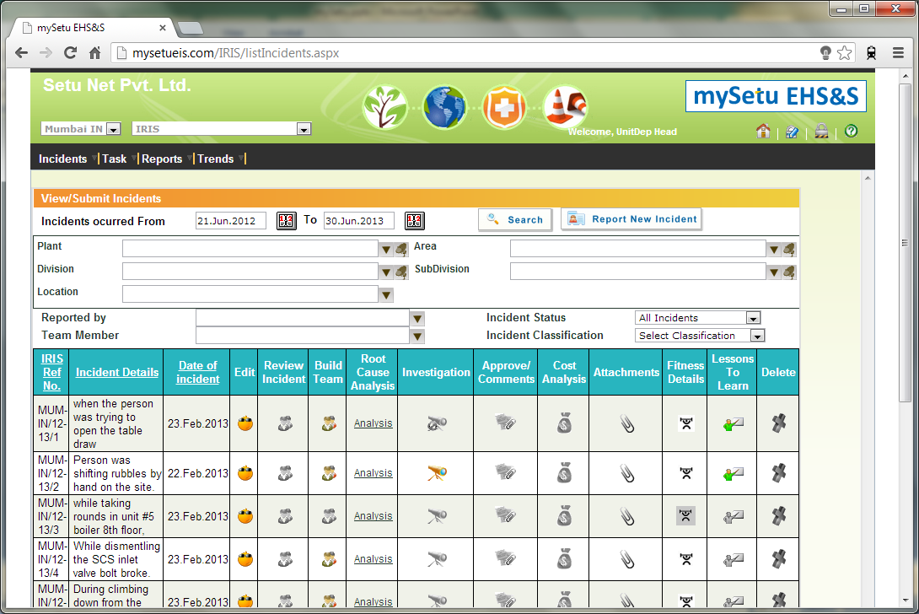
UDH – Incidents / View-Submit

Slide 34

UDH – Task

Slide 35
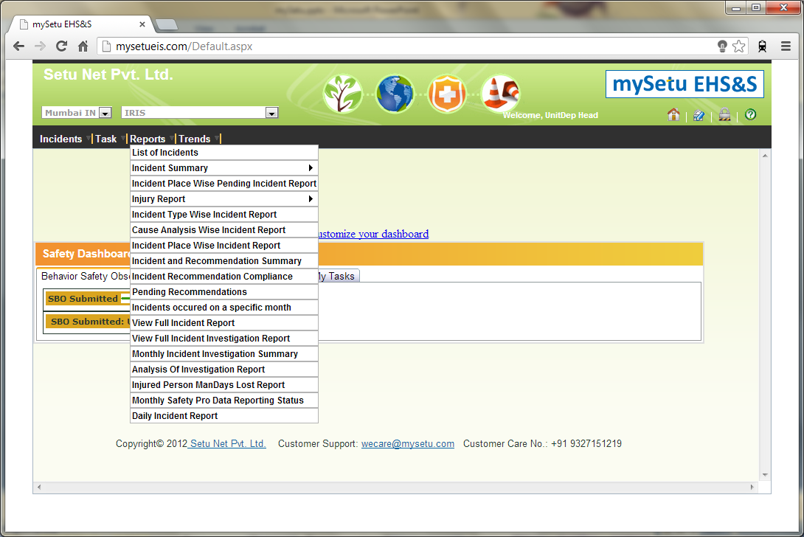
UDH – Reports

Slide 36
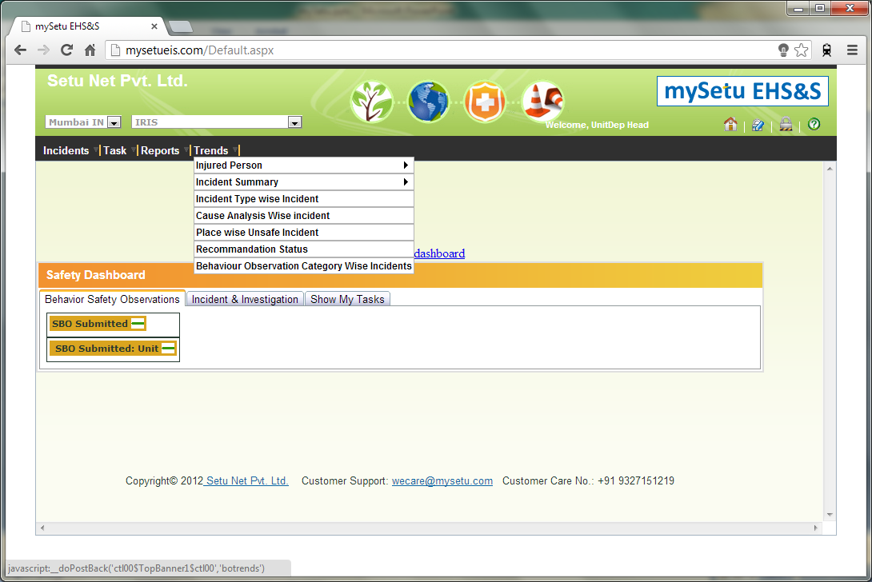
UDH – Trends

Slide 37
Report Incident
Report Incident
View-Submit Incident
Incident Stages
Reports
Trends

Slide 38
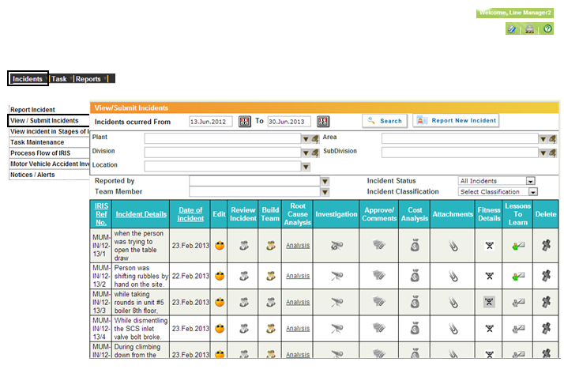
Left-Navigation

Slide 39
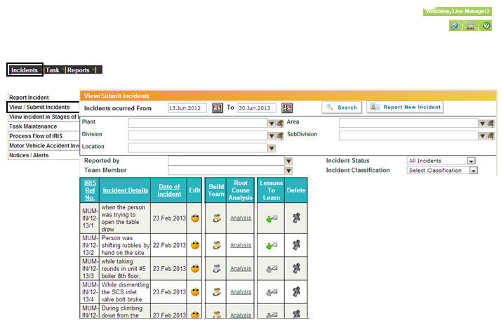
Only Necessary Data

Slide 40
Comparison

Slide 41
Suggestion
Log incident report changes.
Basic design changes like – radio buttons, data view, etc.

